Slide 1
Device library
Andi Jen Foster Teo Nhan

Slide 2
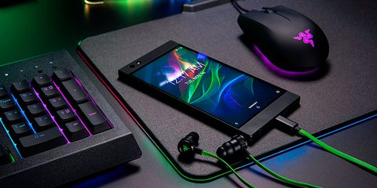
Software and Gaming Company
50 staff
lots of devices
two office buildings

Slide 3

The problem
Who’s got it?
Who had it last?
Whiteboard tracking ☹

Slide 4
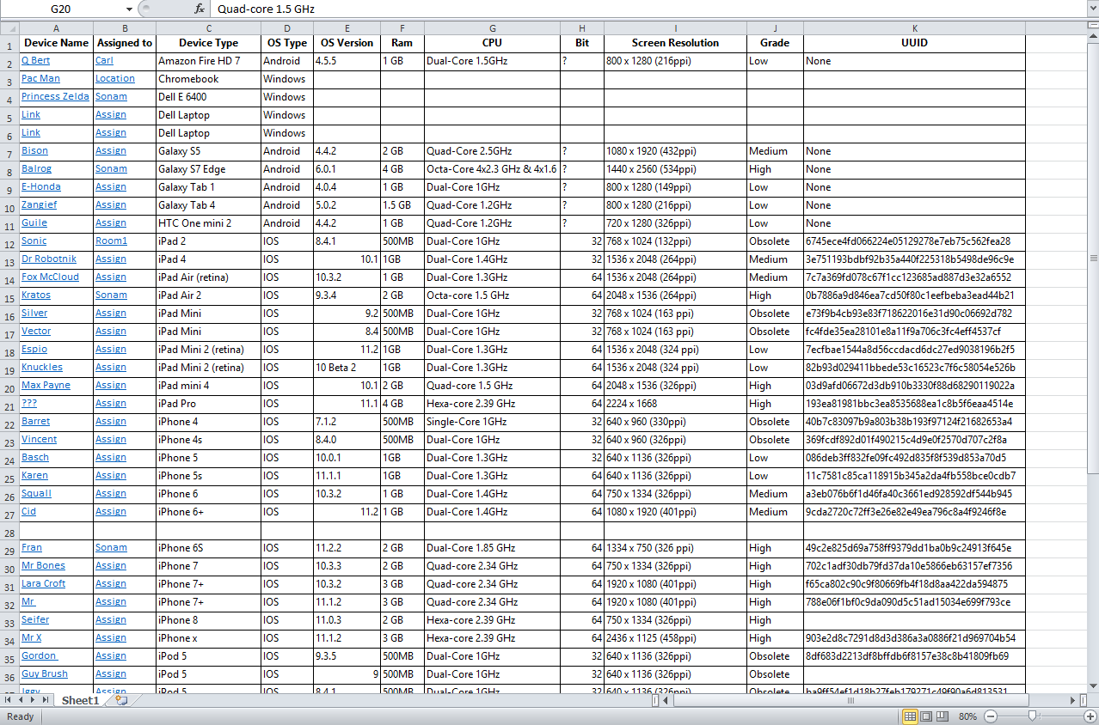
No one knows I exist ☹

Slide 5

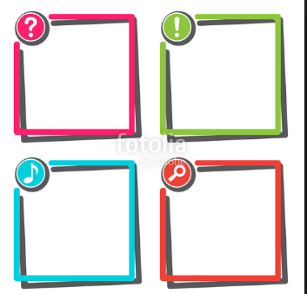
Where
Edit
update
Ping
Specs

Slide 6
Methodology

Slide 7

Notes:
Talked about how we understood the brief and what might be needed.

Slide 8
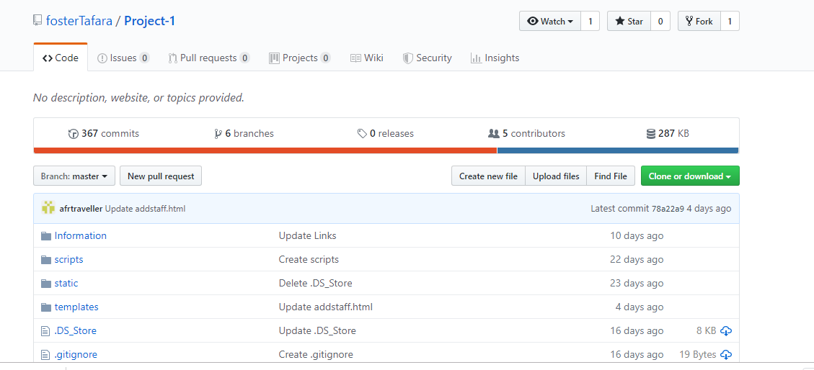

Slide 9
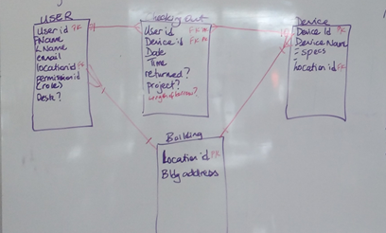
Notes:
Thought about how tables need to look

Slide 10
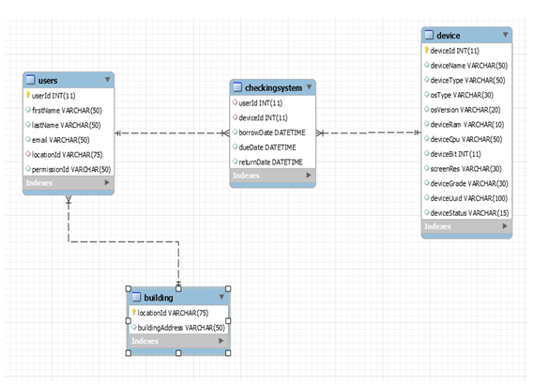
First database model
Notes:
Populated the database with device specs

Slide 11
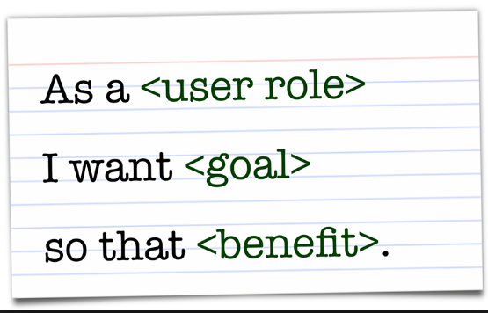
Methodology
Notes:
Went down a rabbit hole imagining stories and researching pinging and geo fencing and rfids and all kinds of stuff that was completely irrelevant stories

Slide 12
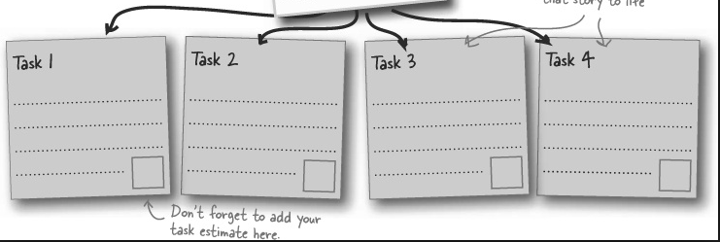
Met the product owner
Notes:
Met the product owner, created a whiteboard mock up of how we saw the UI and broke out the first user stories in to tasks for Sprint 1

Slide 13
Sprint 1

Slide 14
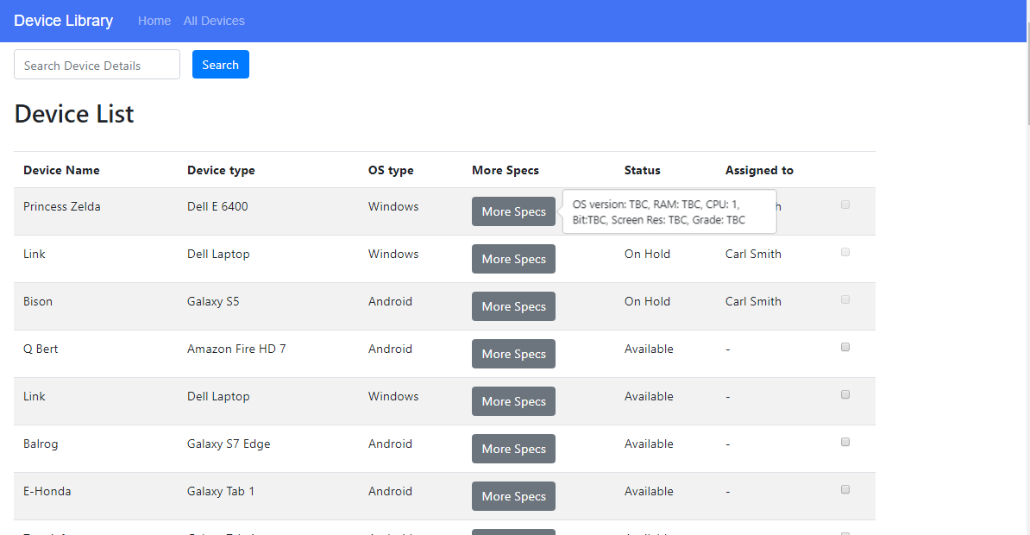
Sprint 1 – device list
See more specifications
Search for all device specifications
tooltip specs / search facility / availability
Show device
status

Slide 15
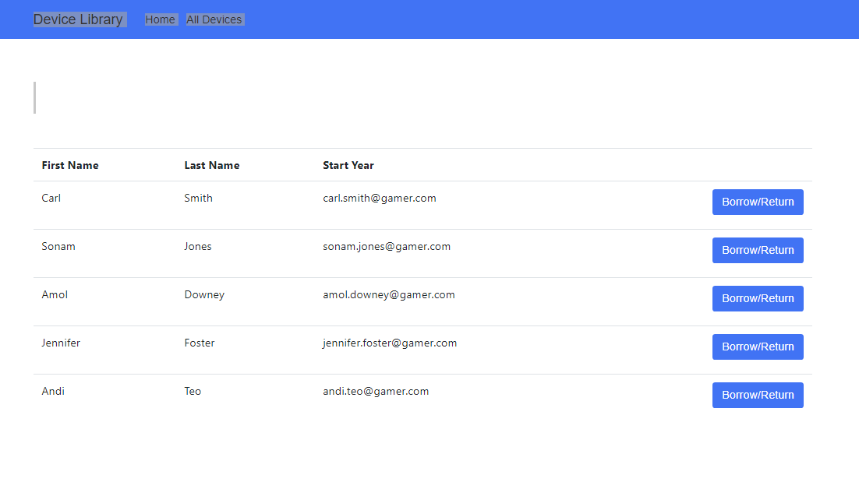
Sprint 1 – user sign in
Access the user page using the Borrow/Return button

Slide 16
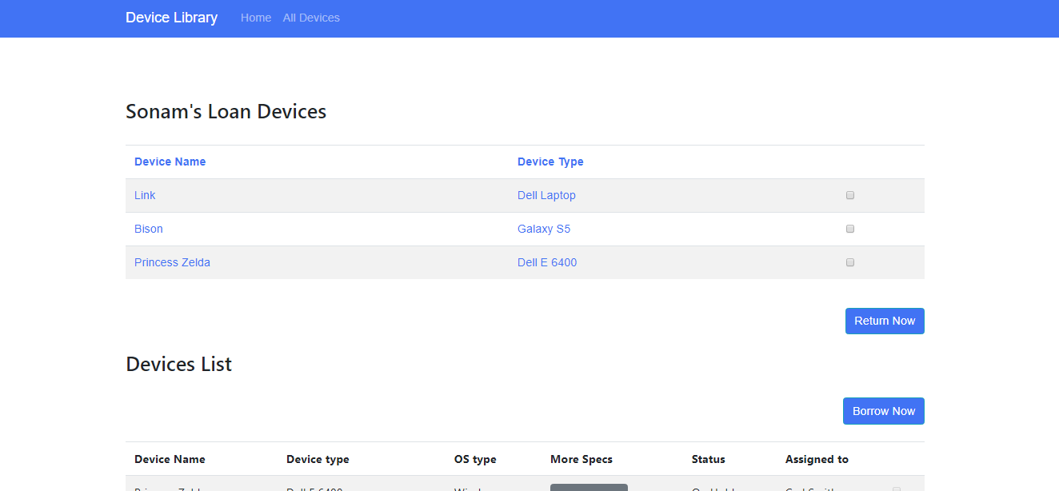
Sprint 1 – user view
Checkboxes to borrow and return and devices updated

Slide 17
Sprint 1 retrospective
No product owner meeting for the first 1.5 days - spent a lot of time inventing non stories and researching pinging and logons etc
We didn’t estimate time taken for stories just moved through them taking as long as they needed
Spent a lot of time talking / showing / sharing

Slide 18
Sprint 2
Notes:
On behalf of them I would like to talk you about our Sprint 2

Slide 19

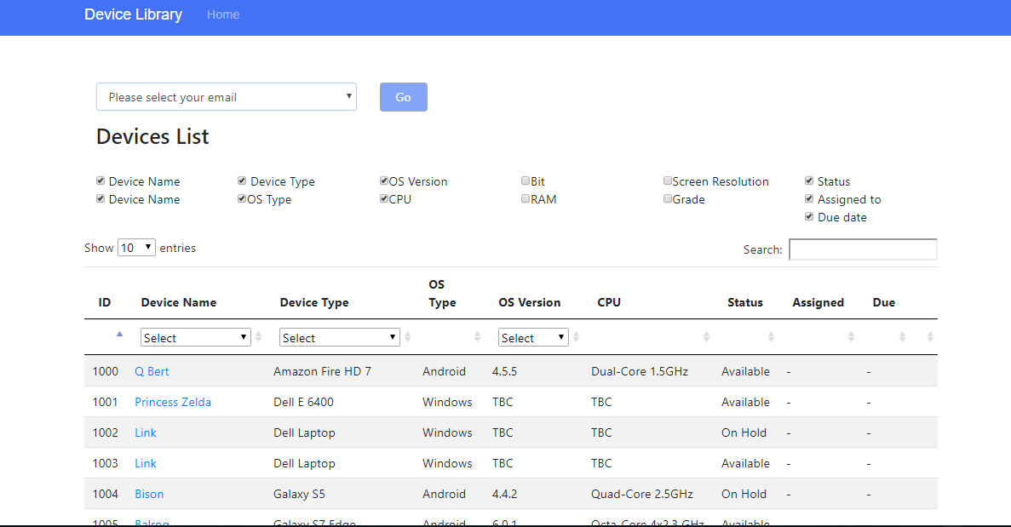
User story 1: All in one page
Sprint 1
Sprint 2
Notes:
After meeting with product owner, we decided that we could manage to implement 3 big following user stories for Sprint 2.
The first user story was to combine the login into the all device page to streamline user experience.
You may remember in Sprint 1, although we have all device page, user needed to move to a separate user list page to login to borrow or return device.

Slide 20
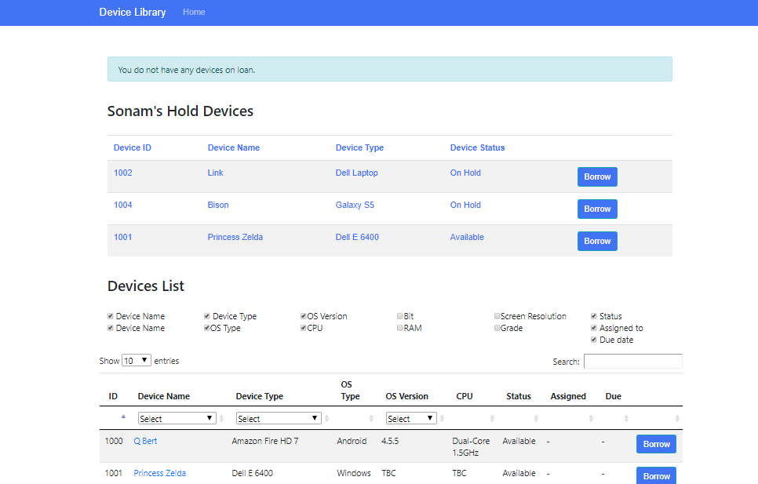
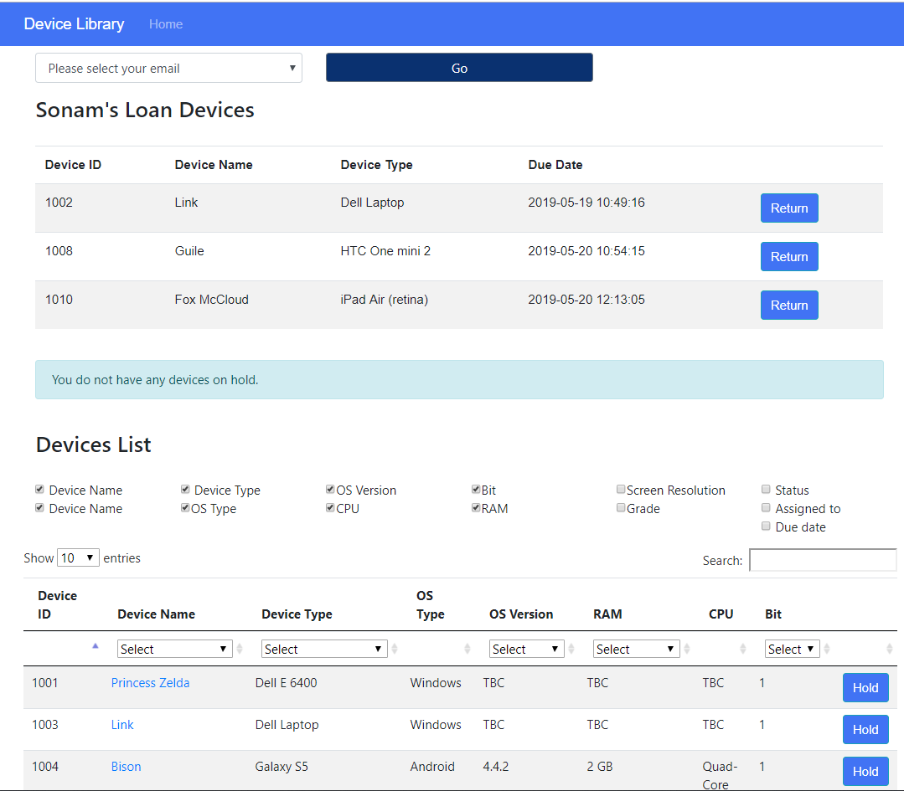
User story 1: After selecting email and pressing “Go”
Return item from loan device list
Borrow item from hold device list
Borrow or hold from the device list
Notes:
After selecting email and pressing “Go”, the user can see user’s loan device list and hold device list if any at the top and the device list was pushed down underneath.
The user can borrow or hold a device from device list and this item will be shown in the loan list or hold list accordingly.
The device in user’s loan list will be removed from device list underneath but the device in user’s hold list was still there. However, user cannot hold it again if it was already in user hold list.

Slide 21
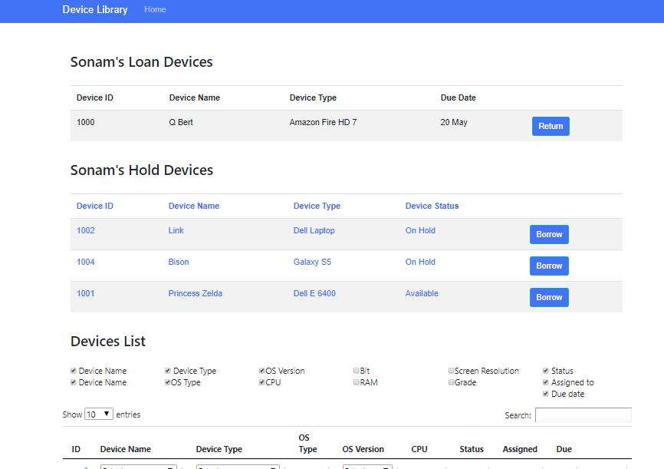
User story 2: Holding function
Notes:
The next user story was to be able to put hold on an item that was already on loan with someone else.
After discussion with product owner, we agreed on the parameters on holding function.
One was the limit on number of people in the holding queue to 3 users.
The other was to create the expiry date for the hold which was user had 2 days to collect the holding item or it would be available for the next person in the queue.

Slide 22
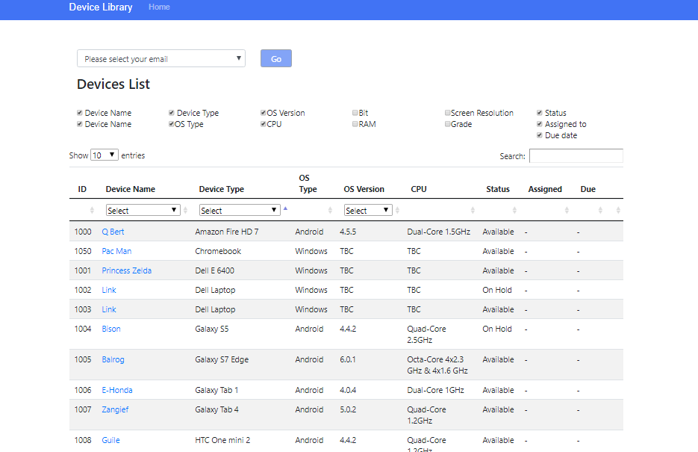
User story 3: Full functions of search, filter, sort
Filters
Search
Sort
Notes:
Besides search function in sprint 1, product owner would like us to implement the filter and sort functions for all device lists.
checkboxes to expand the view to all specifications
specifications are able to be filtered with the filter dropbox under the header of the column
User can also sort the result

Slide 23
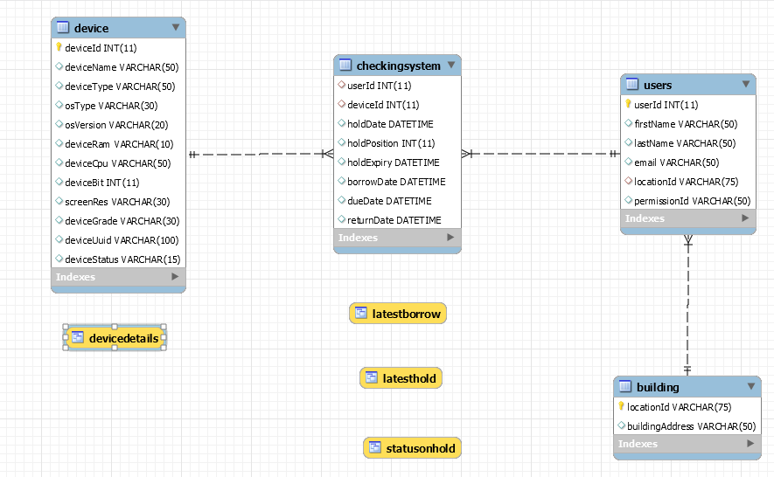
Sprint 2 Retrospective
Notes:
We learnt about MySQL views and set up some of these
We learnt about defining functions for things that are used more than once

Slide 24
Sprint 2 Retrospective (Cont)
We learnt about “work-around” solution when we cannot implement what we want to do
Limit each scrum meeting to 5mins and keep “show –tell” distinct from “stand-up”
Encouraged to predict time for each story and check out

Slide 25
Sprint 3

Slide 26
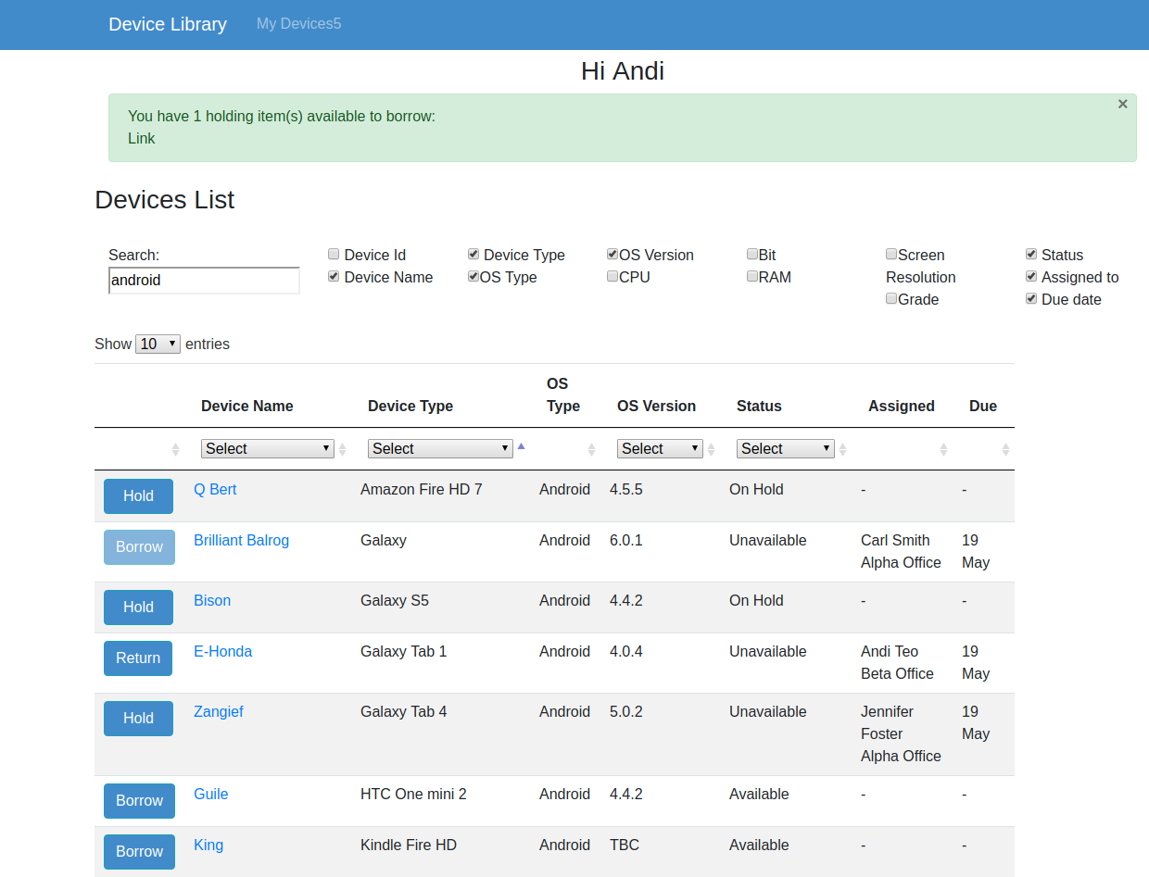
User story: Logged in homepage
Notes:
1) The first key user story was making the homepage be reflective of the logged in user.
The list need to show all the devices, but the buttons reflected the situation of the person logged in. Consequently the buttons shown are
Return: If the user already has the item on loan
Hold: if the device is booked out to another user and you are able to put a hold on it.
Borrow, if the device is available for you to borrow
There is also a disabled hold button if you already have the device on hold and it is not yet available for you to borrow.

Slide 27
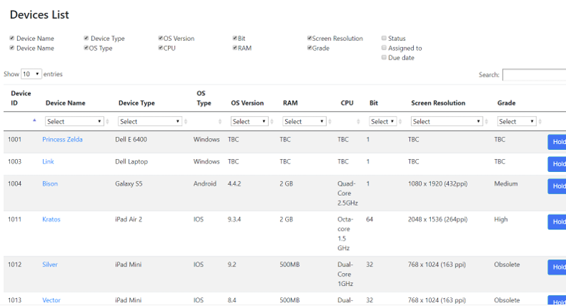
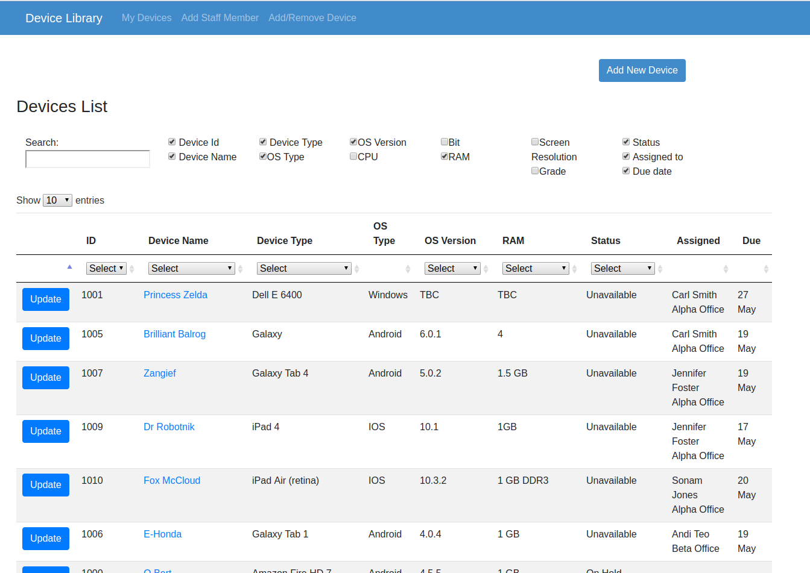
User story: Buttons and search visibility
Notes:
Make search and borrow buttons always visible, by shifting these functionality items to the left of the screen, so they don’t overflow
Also to see the location of borrowed devices

Slide 28
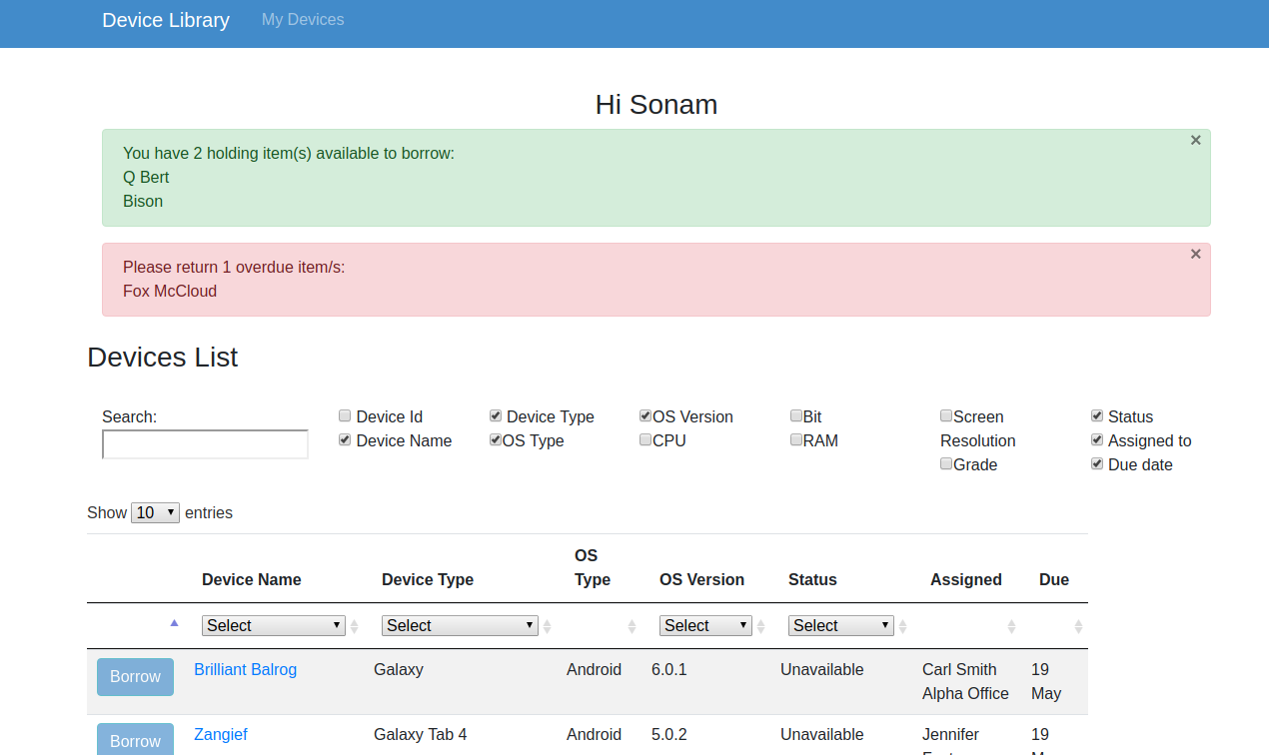
User Story: Messages
Notes:
Three user stories were related to messages to users to advise them of status updates of their items.
message notification when my holds become available
message notification when my device is due back soon
message notification when my device is overdue

Slide 29
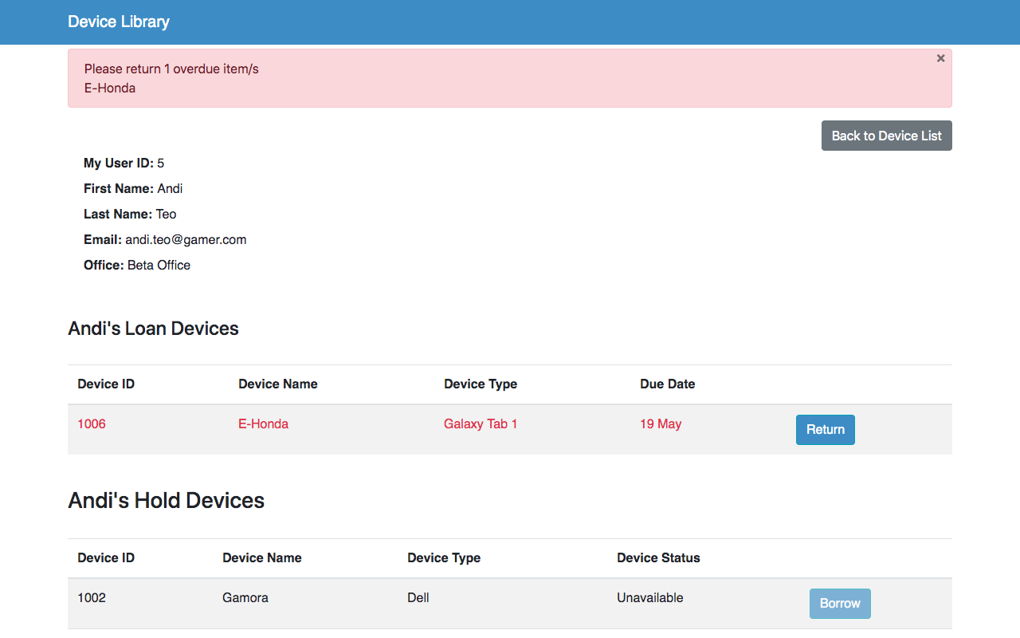
User Story: My View
Notes:
The product owner also asked us to add a profile page to the logged in site to create an additional simple view where users can just see the items on loan, or on hold, in holds newly available that could now be borrowed.

Slide 30
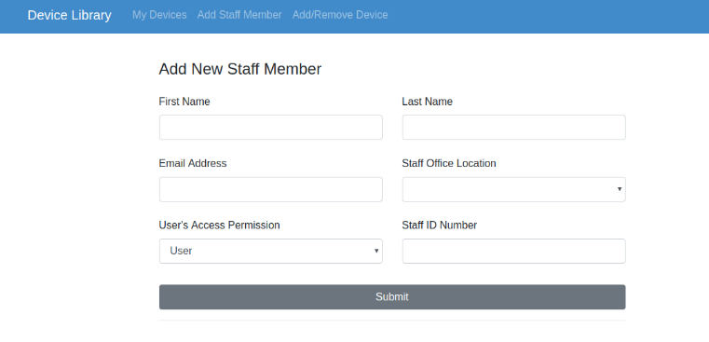
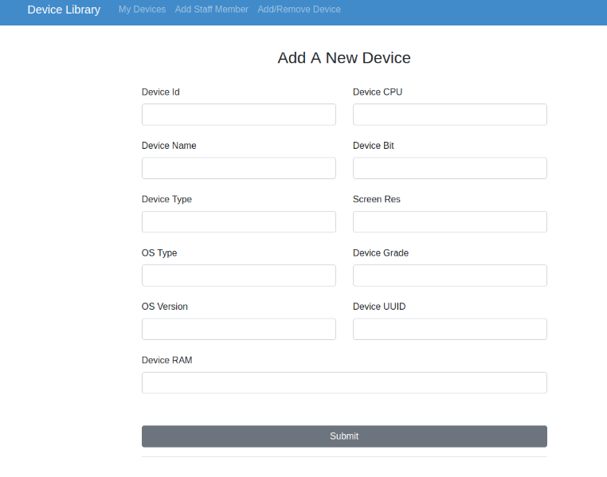
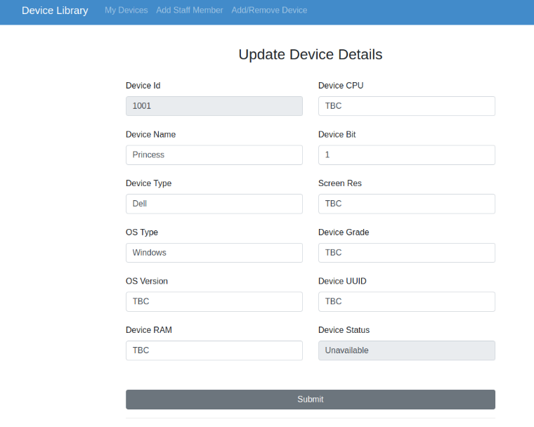
User Story: Additional Admin Functions
Notes:
Had a little bit of extra time, so decided to add some additional items. We chose two admin functions as these were the next in the priority list that we believed we had time to complete.
We then created options in the Nav Bar to allow admin access to these functions

Slide 31
Sprint 3 learnings
Better planning of task timings
Optimising code – reduce rendering by changing the order of the code.
Don’t get too hung up on your code, as the product owner might change their requirements, and certain functions will no longer be needed.
Notes:
We did some planning of tasks at the beginning of S3, and though our individual estimations weren’t consistent for each task the overall estimation only varied by 5 hours between the lowest and highest totals across the team….
Optimise the code by reducing rendering due the order of the code.
Hold items didn’t need to show in bottom view in Sprint 1 & 2, but when it became an ALL view, this was no longer relevant.

Slide 32
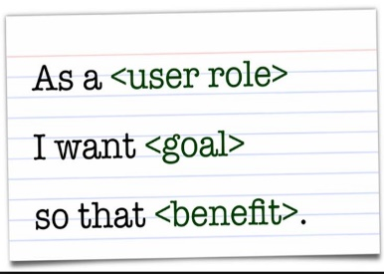
Sprint 3 MVP – Foster???
Need to summarise in words what we got done here and as part of final artefact segment??
No need for screen shots because we will demo product

Slide 33
Prioritised stories not delivered – Foster??
As a user I want to
see my place in the queue so that I can use when it becomes available (moved to sprint 2 and then sprint 3 where it was ranked 15)
You do get notification when it comes available and 2 days to collect
Renew (extend a loan for 3 more days)
Logon?

Slide 34
User stories for Sprint 3 (not done) – Foster?
As a logged in user I want
page layout to remain when viewing 10 or 100 devices
notification if someone puts a hold on a device I have out

